Slide 1
Session Management Sessions and Listeners Technique: Error Handling in Servlets #Session #UrlRewriting #HiddenForm #SessionTracking #Cookie #ShoppingCart #ErrorHandle #JSP

Slide 2
Review
JSP
JSP Syntax
Comment
Scripting Element: declaration, scriptlets, expression
Directives (page, include, taglib)
JSP Life Cycles
JSP Implicit Object
MVC Pattern
No MVC
MVC 1
MVC 2

Slide 3
Objectives
Build the Web Application?
Session Tracking Techniques
Break down structure component in building web application
Techniques: Error Handling in Servlets
Reporting Errors
Logging Errors
Users Errors vs. System Errors

Slide 4
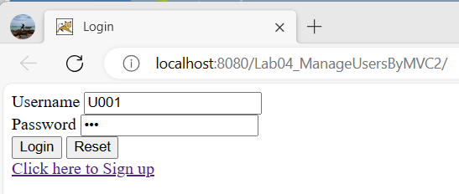
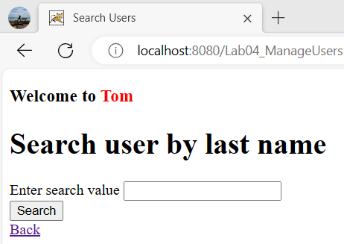
Build a Web App Expectation

Slide 5
Sessions & Listeners Session
Is the period of connection between client and server
Is a group of activities that are performed by a user while accessing a particular web site
HttpSession are virtual connection between client and server
Web container reserves an individual memory block for storing information about each session → Session objects.
The session tracking (mechanism)
Serves the purpose tracking the client identity and other state information required throughout the session
Allows the server to keep a track of successive requests made by same client
Allows the customer to maintain the information with the server as long as the customer does not log out from the website

Slide 6
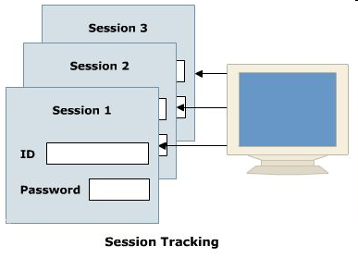
Sessions & Listeners Session Tracking Techniques
URL Rewriting
Hidden form field
Cookies
HttpSession interface

Slide 7
Sessions & Listeners URL Rewriting
Maintains the state of end user by modifying the URL.
Adds some extra data at the end of the URL
Is used when the information to be transferred is not critical.
Syntax: url?query_string
Ex
<a href=“http://localhost:8080/Books?category=java”> Java Books </a>
<form action=“http://localhost:8080/UpdateProfile?uid=123” method=“get”> ---------- </form>
Disadvantages:
Server side processing is tedious.
Every URL that is returned to the user should have additional information appended to it.
If the user leaves the session and opens the Web page using a link or bookmark then the session information is lost.
The query string is limited
Notes:
Tedious : tẻ nhạt, buồn chán

Slide 8
Sessions & Listeners Hidden Form Fields
Simplest technique to maintain the state of an end user.
Insert the session identifier into the hidden form field in the HTML of each page
Embedded the hidden form field in an HTML form and not visible when you view an HTML file in a browser window.
The session information can be extracted by the application by searching for these fields. The servlets or JSP pages read the field using request.getParameter().
Syntax
<input type=“hidden” name=“…” value=“…”>
Ex
<input type=“hidden” name=“productId” value=“P01”>
Advantages
Simplest way to implement session tracking
Displays nothing on the HTML page but can be used to hold any kind of data
Helps to maintain a connection between two pages
Disadvantages:
Work on the dynamic pages.
This method of session tracking displays sensitive information to the user.

Slide 9
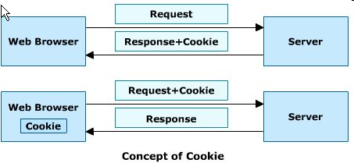
Sessions & Listeners Cookies
Is a small piece of information sent by the web server to the client to keep track of users.
Size of each cookie can be a maximum of 4 KB.
Cookie has values in the form of key-value pairs
When the server sends a cookie, the client receives the cookie, saves and sends it back to the server each time the client accesses a page on that server
Can uniquely identify a client (In the case of J2EE web applications, the cookie returned has a standard name JSESSIONID and store in memory)
A web browser is expected to support 20 Cookies per host

Slide 10
Sessions & Listeners Cookies
Advantages
Remember user IDs and password.(low security)
To track visitors on a Web site for better service and new features.
Cookies enable efficient ad processing.
Support e-advertisement on Internet and Security (can not affect virus).
Disadvantages
Personal information is exposed to the other users. (spam/ junk mail, pop up …)
Cookies fails to work if the security level is set too high in the Internet browser.
Most browsers enable the user at the client machine to deactivate (not to accept) cookies.
The size and number of cookies stored are limited.
Note
Browser is accepted cookies
Cookies are stored at
C:\Documents and Settings\LoggedUserName\Cookies\LoggedUserName@ContextPath[n].txt
C:\Users\LoggedUserName\AppData\Local\Microsoft\Windows\Temporary Internet Files \LoggedUserName@host[n].txt
C:\Users\”UserName”\AppData\Local\Microsoft\Edge\User Data\Default\Network
Cookies are existed following the setMaxAge and deleted automatically by OS
Notes:
C:\Users\SwordLake\AppData\Local\Microsoft\Edge\User Data\Default\Network

Slide 11
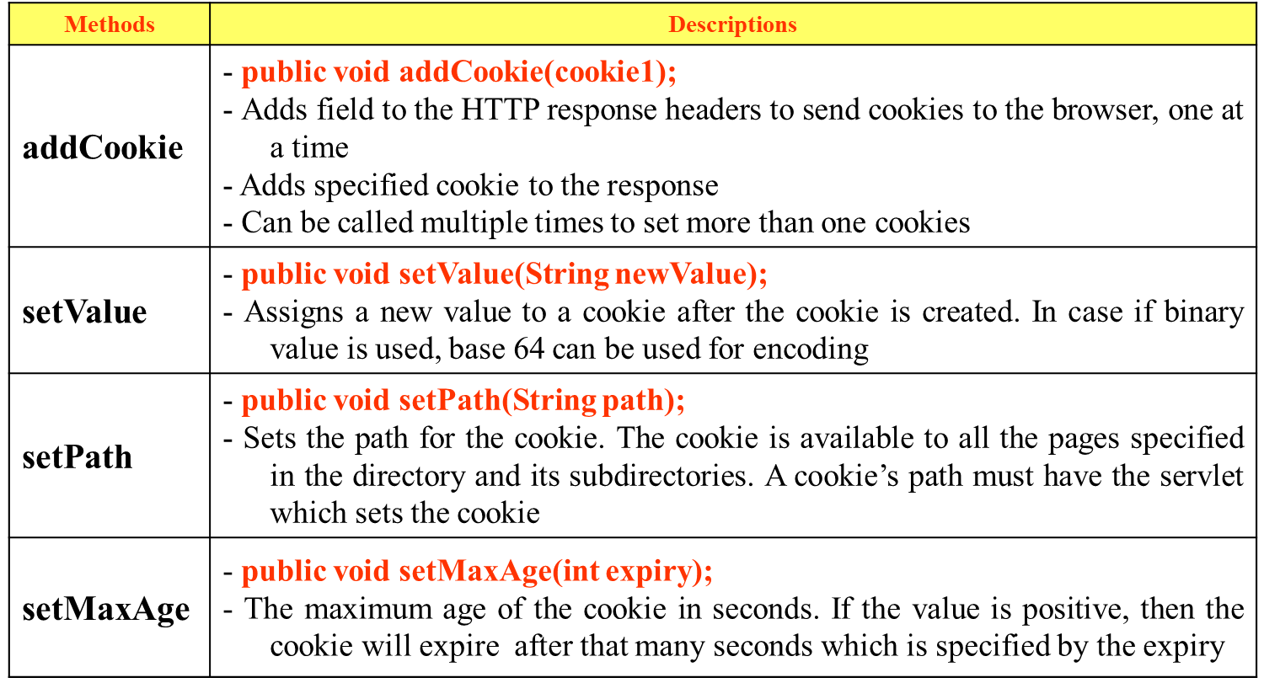
Sessions & Listeners Cookies
The servlet API provides javax.servlet.http.Cookie class for creating and working with cookies
The constructor for the cookies class is: Cookie(java.lang.String name, java.lang.String value)
Sending Cookie

Slide 12
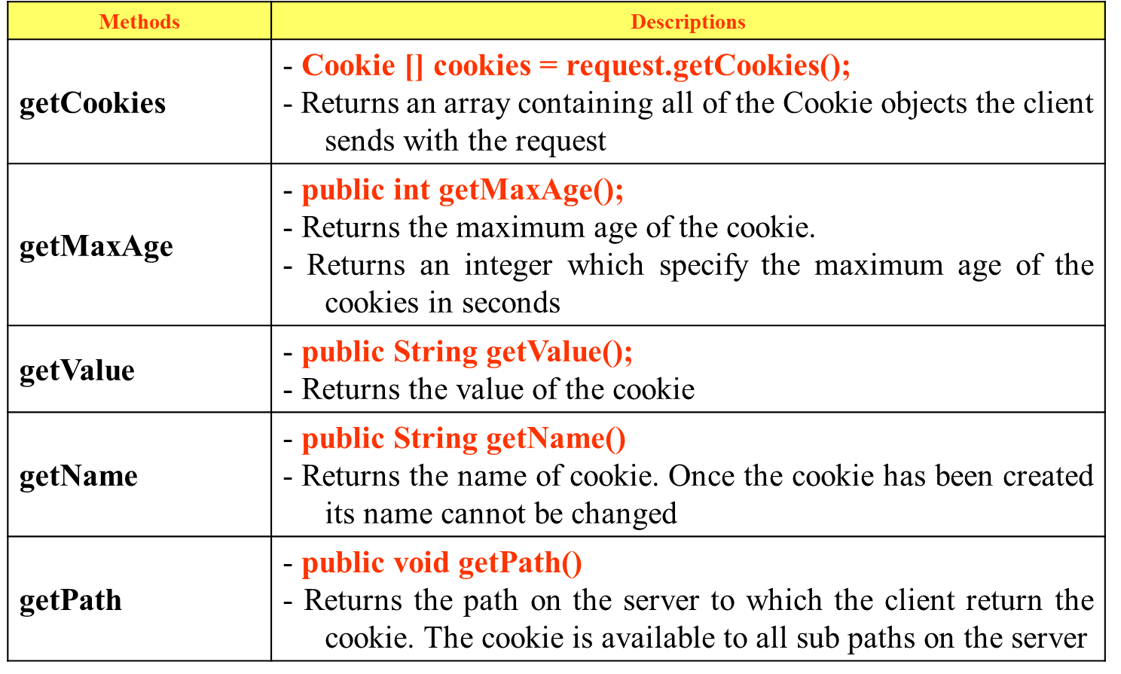
Sessions & Listeners Cookies
Reading Cookie

Slide 13
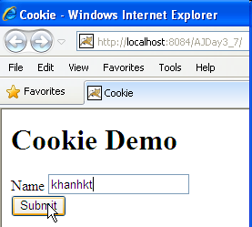
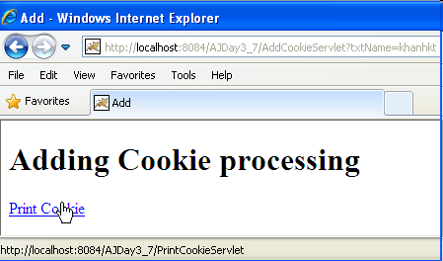
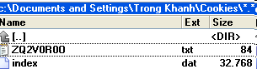
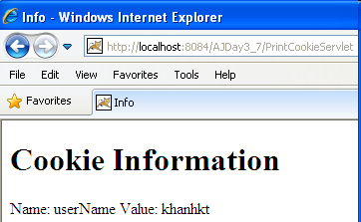
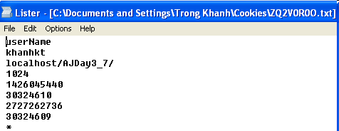
Sessions & Listeners Cookies – Example
#1. Create demoCookie.html
#2. Create AddCookie Servlet.java
#3. Create PrintCookie Servlet.java

Slide 14
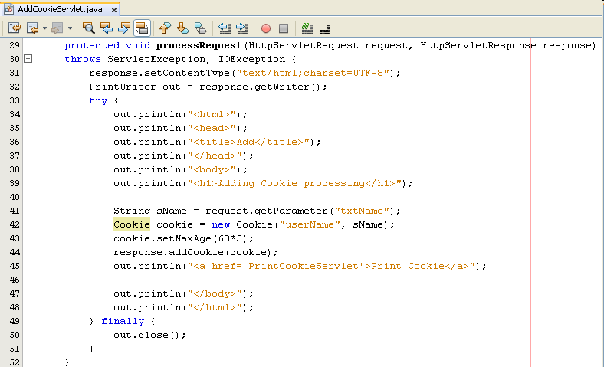
Sessions & Listeners Cookies – Example
Create AddCookie Servlet.java

Slide 15
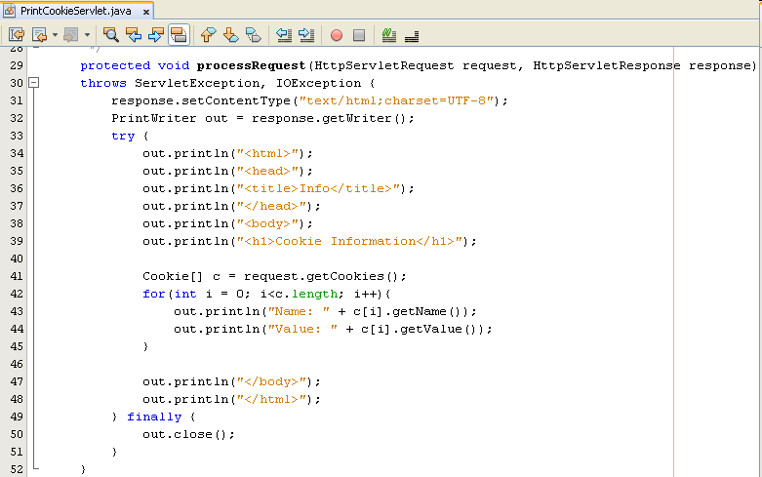
Sessions & Listeners Cookies – Example
Create PrintCookie Servlet.java

Slide 16
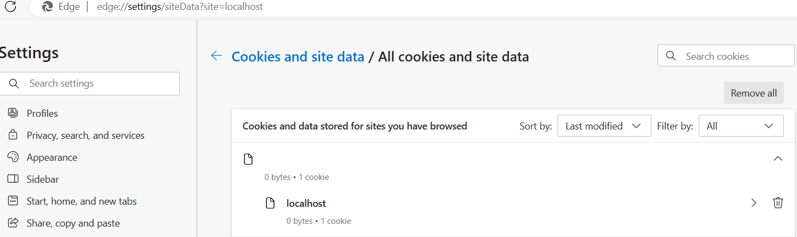
Sessions & Listeners Cookies – Example
On Windows 11
Microsoft Edge : C:\Users\”UserName”\AppData\Local\Microsoft\Edge\User Data\Default\Network

Slide 17
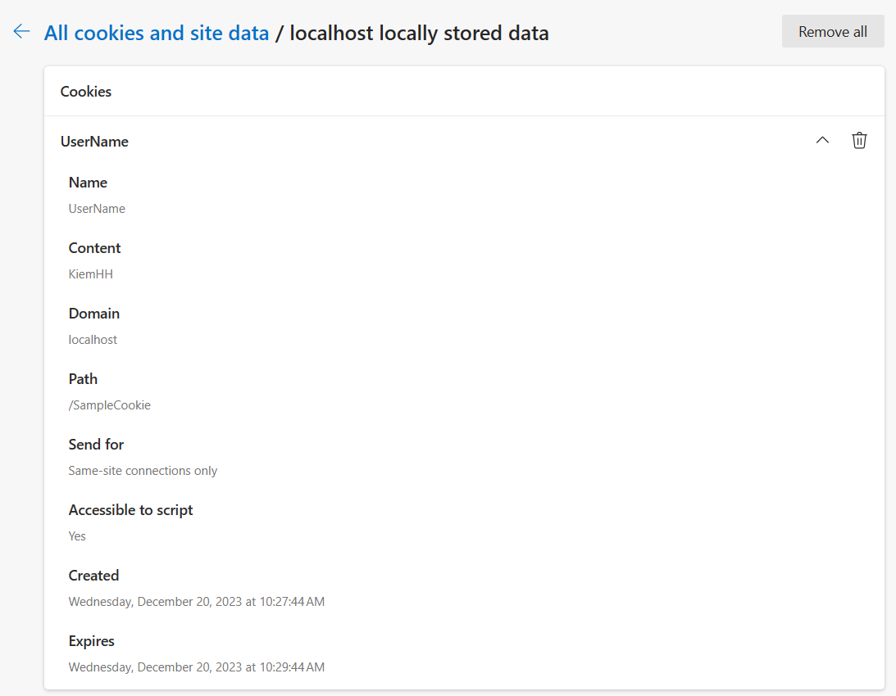
Sessions & Listeners Cookies – Example
Google Chrome : C:\Users\”UserName”\AppData\Local\Google\Chrome\User Data\Default\Network

Slide 18
Sessions & Listeners Session Management: General Principles
Each of these requests needs to carry a unique ID, which identifies the session to which it belongs.
The web application will allocate this unique ID on the first request from the client.
The ID must be passed back to the client so that the client can pass it back again with its next request. In this way, the web application will know to which session the request belongs. This implies that the client must need to store the unique ID somewhere—and that’s where session management mechanisms come in
The default mechanism for session management is cookie

Slide 19
Sessions & Listeners HttpSession interface
Identifying user in a multi-page request scenario and information about that user
Is used to created a session between the client and server by servlet container
When users make a request, the server signs it a session object and a unique session ID
The session ID matches the user with the session object in subsequent requests
The session ID and the session object are passed along with the request to the server
Session Timeout
Is necessary as session utilizes the memory locations
Prevent the number of session increasing infinitely.
Set either in the web.xml file or can be set by the method setMaxInactiveInterval()

Slide 20
Sessions & Listeners HttpSession interface Methods
Methods | Descriptions
getSession | - request.getSession(boolean create); - Obtain a current session objects - The getSession() method with true parameter is used to create a new session (no current session)
getId | - public String getId() - Returns a string containing the unique identifier assigned to this session. The servlet container assigns the identifier and it is implementation independent
getCreationTime | - public long getCreationTime() - Returns the creation time of session.
getLastAccessedTime | - public long getLastAccessedTime() - Returns the last accessed Time of session
getMaxInactiveInterval | - public int getMaxInactiveInterval() - Returns the maximum time interval, in seconds, for which the servlet container will keep the session alive between the client accesses
setMaxInactiveInterval | - public void setMaxInactiveInterval(int interval) - Specifies the time, in seconds, between the client requests before the servlet container invalidates the current session

Slide 21
Sessions & Listeners HttpSession interface Methods
Methods | Descriptions
isNew | - public boolean isNew() - Returns true if the client is unaware about the session or choose not to be part of the session
invalidate | - public void invalidate() - Invalidates the session and the objects bound to the session are bounded. This method throws IllegalStateException if called on already invalidated session - To avoid the hacker from causing any harm - Destroys the data in a session that another servlet or JSP might require in future. Therefore, invalidating a session should be done cautiously as sessions are associated with client, not with individual servlets or JSP pages

Slide 22
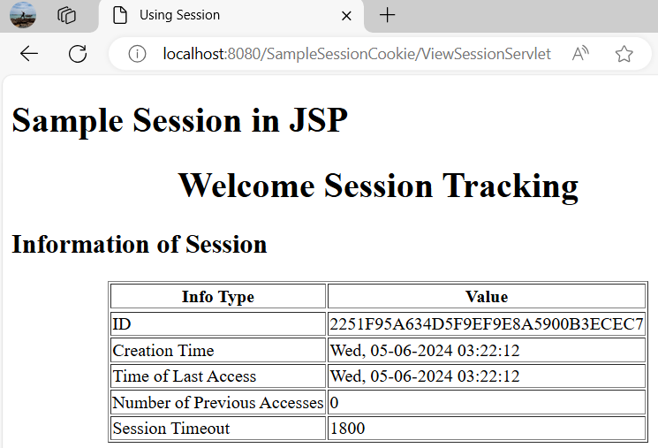
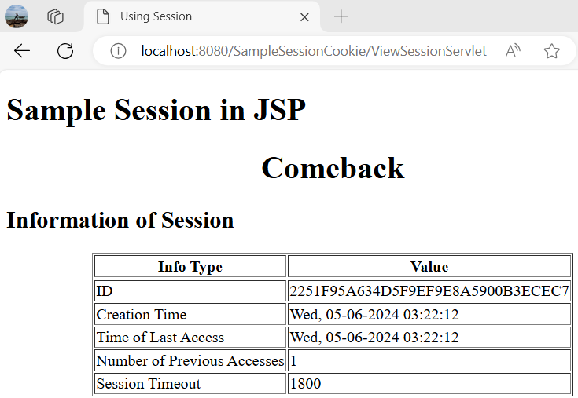
Sessions & Listeners HttpSession interface – Example

Slide 23
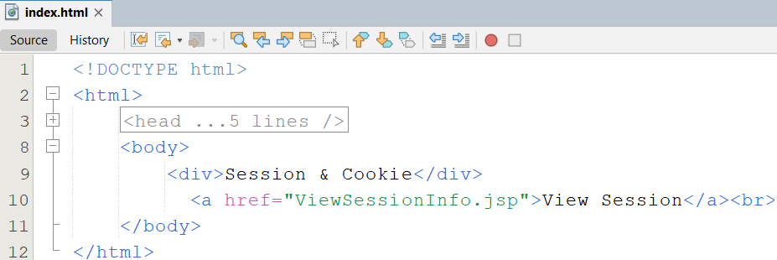
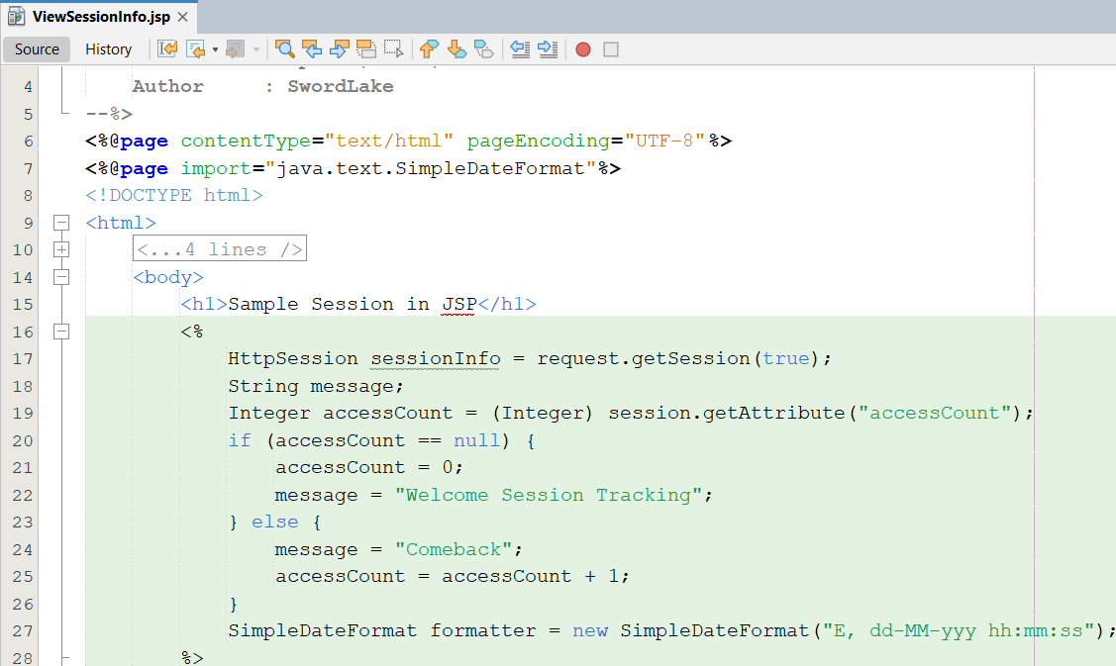
Sessions & Listeners HttpSession interface – Example
#1. Create index.html
#2. Create ViewSessionInfo.jsp

Slide 24
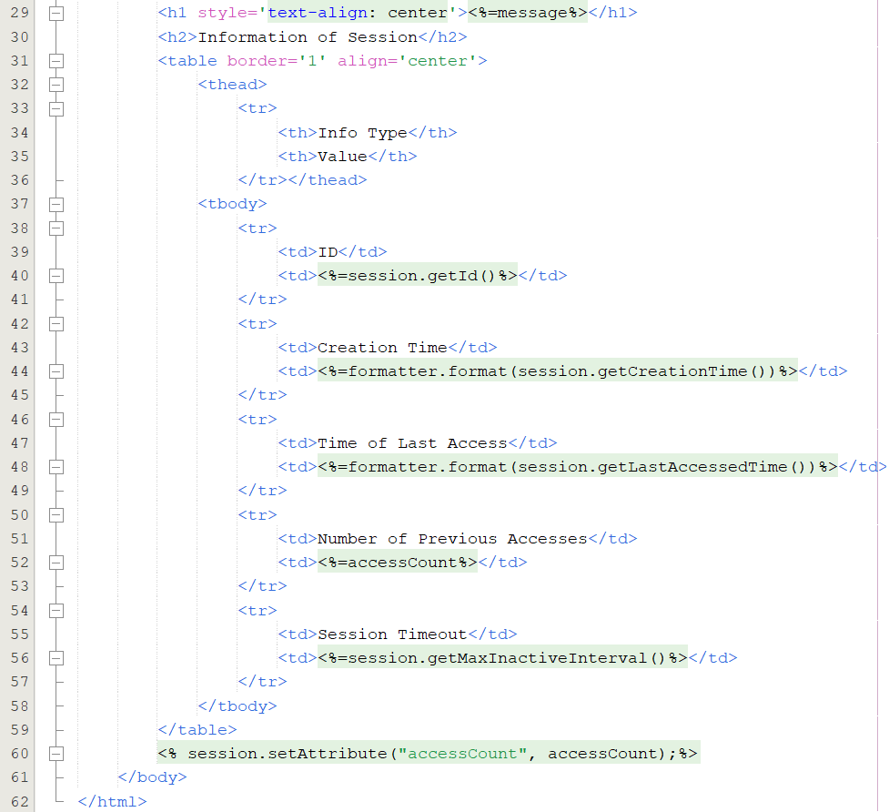
Sessions & Listeners HttpSession interface – Example

Slide 25
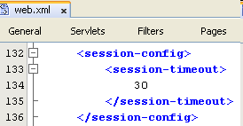
Sessions & Listeners HttpSession interface
Distributed Session
A session is available to be shared between web resources in a single web application (e.g. a session cannot cross web application boundaries)
Session Death is controlled in one of 3 ways
Application Server Global Default
Web Application Default (minutes)
A negative value or zero value causes the session to never expire
Individual Session Setting using setMaxInactivateInterval() method
A negative value supplied as an argument causes the session to never expire
Other Session APIs
HttpSession.getServletContext() returns the SessionContext that the session is attached
Notes:
Session timeout : 30 minutes in Tomcat

Slide 26
Sessions & Listeners HttpSession interface
How to store value?

Slide 27
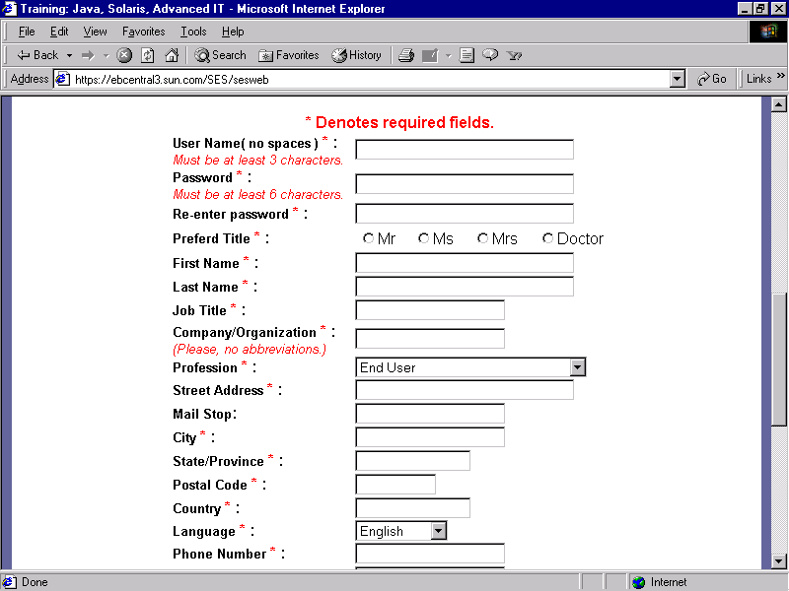
Sessions & Listeners HttpSession interface
1. Input and click button/link
3. Send request
4. Dispatch to Servlet/Web Container
Web/App Server
Containter
10. Send response & store in cookie
9. Attach ID to response
5. Send
2. Generate the Request msg
8. Manipulate (if any)
Resources
OS
SessionObject
6. create Session Obj
7. Assign Session ID to Session Object
Client
Server

Slide 28
Sessions & Listeners HttpSession interface
1. Input and click button/link again (2..n)
3. Send request
4. Dispatch to Servlet/Web Container
Web/App Server
Containter
10. Send response
5. Send
7. Response
2. Generate the Request msg with id session
Resources
OS
SessionObject
6. Manipulate (if any)
Client
Server

Slide 29
Sessions & Listeners Conclusion
Store data/object at server site But, SessionID is stored at client
Session object
Tracking Session Mechanism
Located at client’s system fie
Cookies
Store data/object at client site
Located at query string
URL rewriting
Located on web page and pass via form’s parameter
Hidden form fields

Slide 30
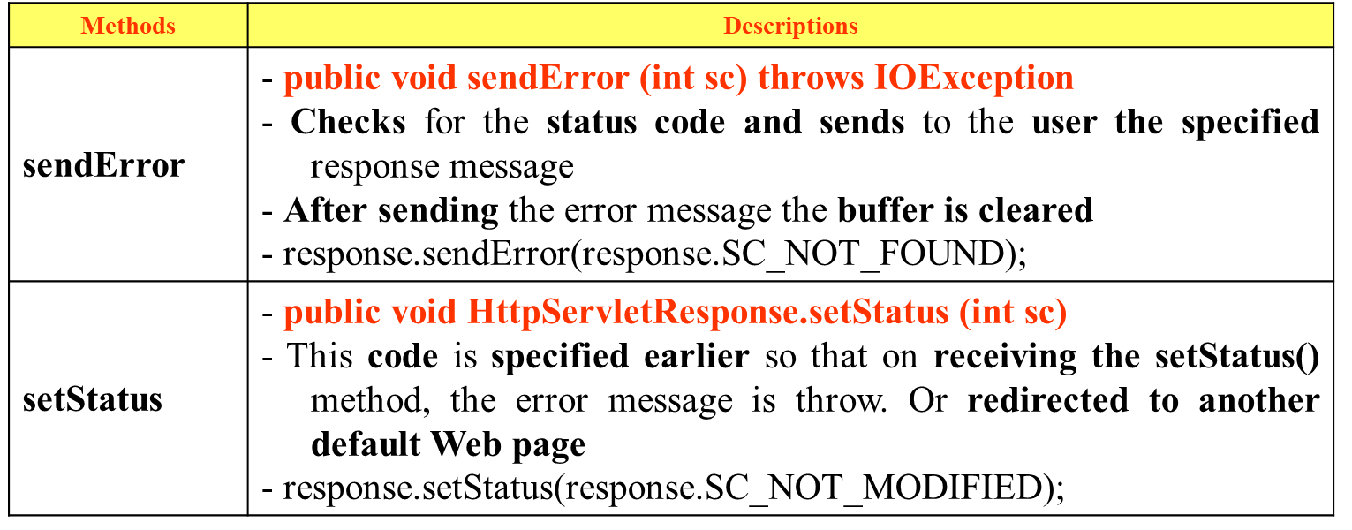
Error Handling in Servlet Reporting Error
There are many situations occur an error
A requested page may be moved from one location to another.
The address may be wrongly typed.
The requested page may be forbidden, may be temporarily deleted or correct HTTP version might not have found.
There are other situations where an error may generated.
Error during the execution of a web application are reported

Slide 31
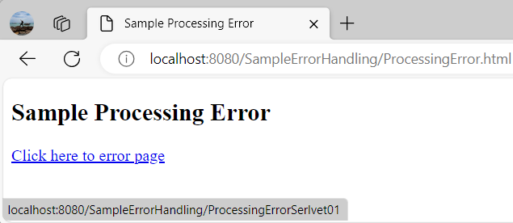
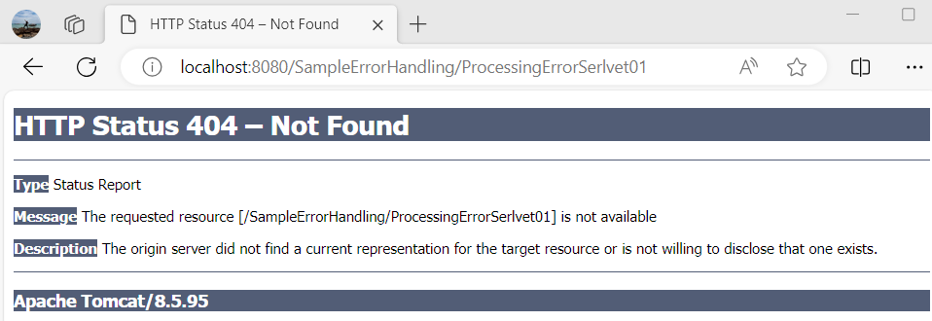
Error Handling in Servlet Reporting Error – Example

Slide 32
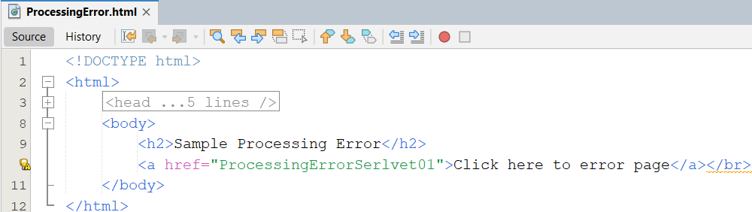
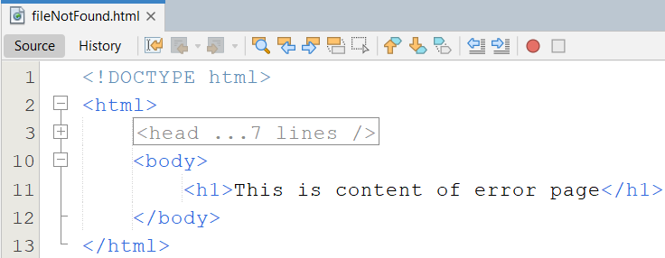
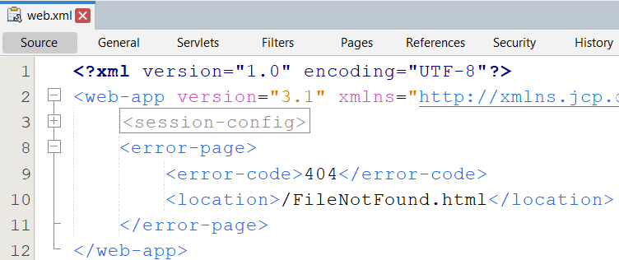
Error Handling in Servlet Reporting Error – Example
1
3
2

Slide 33
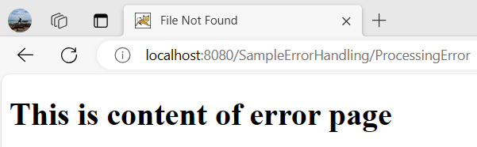
Error Handling in Servlet Reporting Error – Example
4

Slide 34
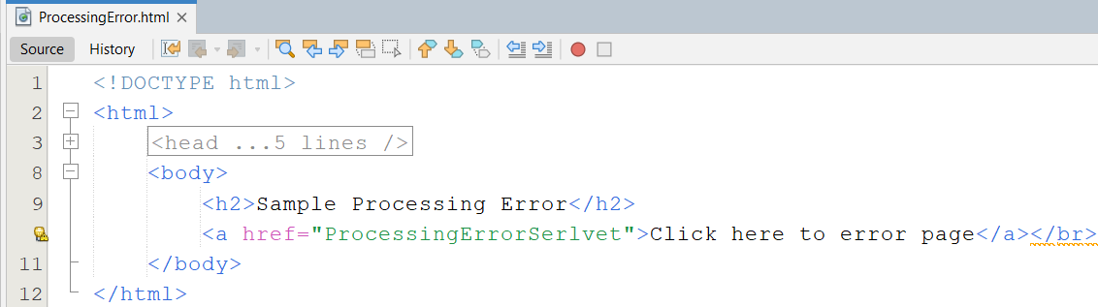
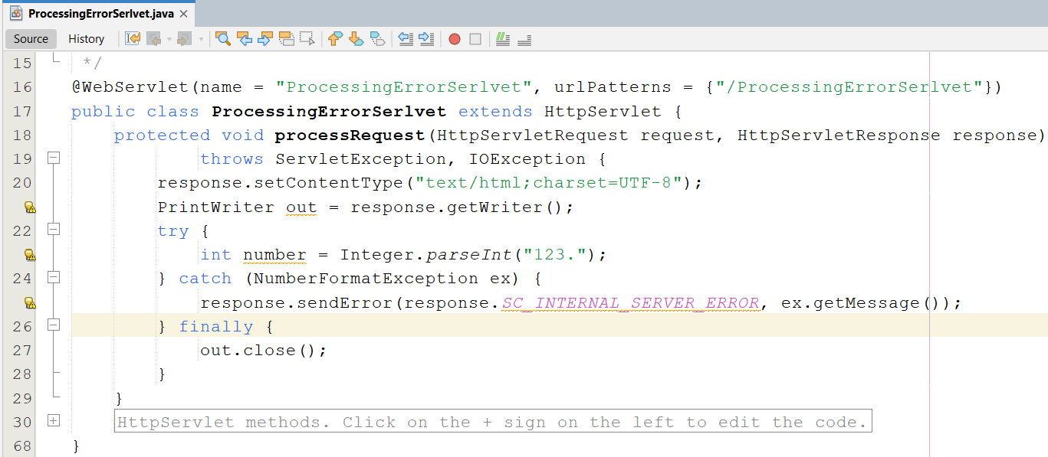
Error Handling in Servlet Reporting Error – Example
1
2

Slide 35
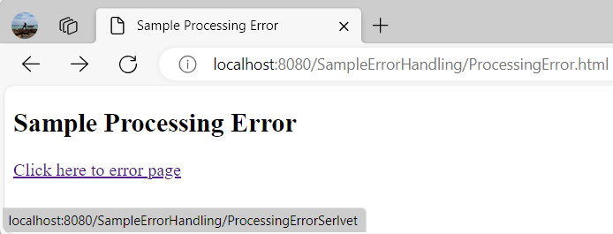
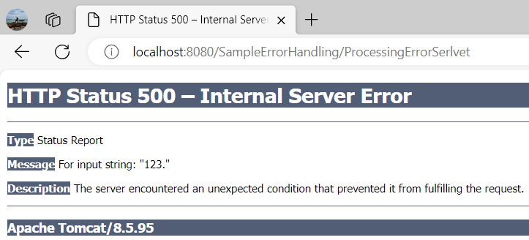
Error Handling in Servlet Reporting Error – Example
3

Slide 36
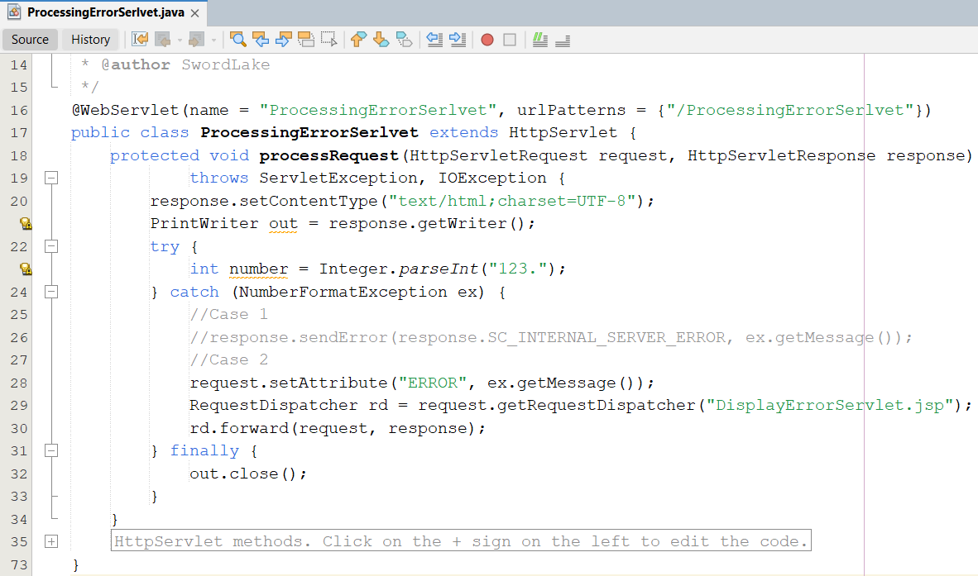
Error Handling in Servlet Reporting Error – Example
1
2
2

Slide 37
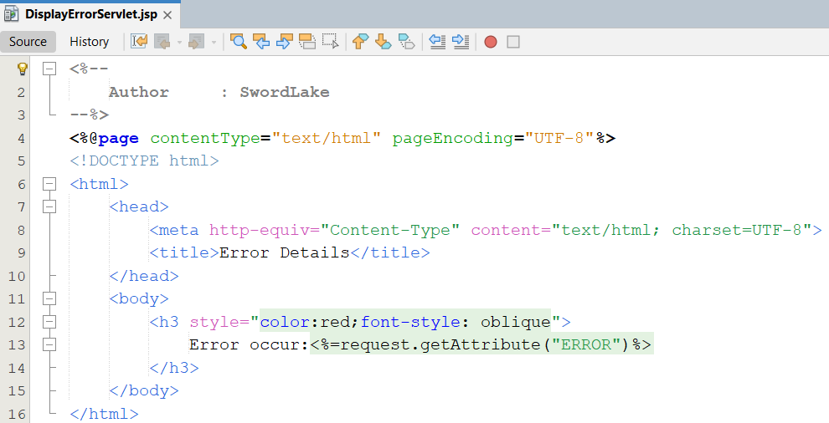
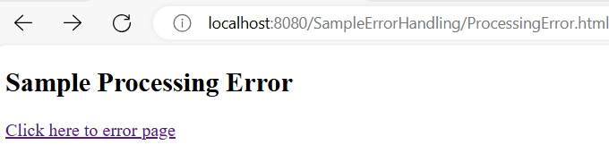
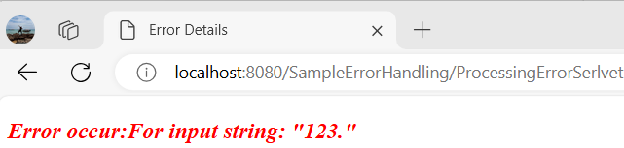
Error Handling in Servlet Reporting Error – Example
3
4

Slide 38
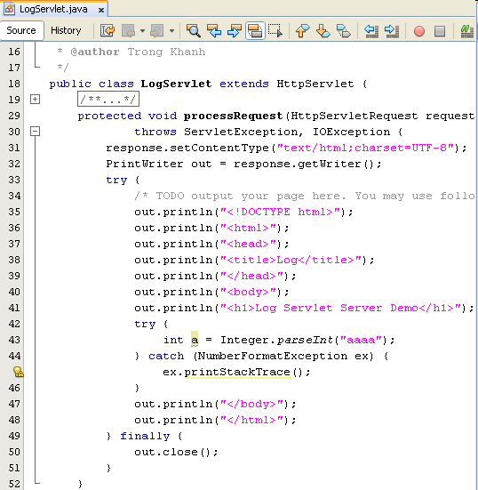
Error Handling in Servlet Logging Error

Slide 39
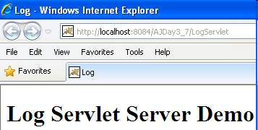
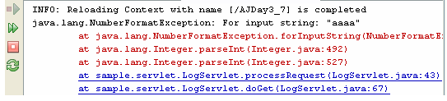
Error Handling in Servlet Logging Error

Slide 40
Error Handling in Servlet Logging Error
Servlet can store the actions and errors through the log() method of the GenericServlet class.
The log() method also assists in debugging and can viewed record in a server
Syntax: public void log (String msg [, Throwable t])
Ex:
…
log("Servlet is not found "); response.sendError(response.SC_INTERNAL_SERVER_ERROR, "The requested page ["+ page + "] not found.");
…
A log file locate at
C:\Documents and Settings\LoggedUser\Application Data\NetBeans\ 7.4\apache-tomcat-7.0.41.0_base\logs\localhost.yyyy-mm-dd.log
C:\Users\LoggedUser\AppData\Roaming\NetBeans\7.4\ apache-tomcat-7.0.41.0_base\work\Catalina\logs\localhost.yyyy-mm-dd.log

Slide 41
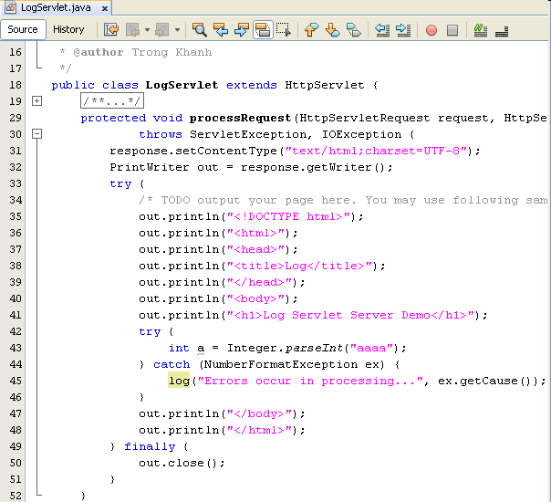
Error Handling in Servlet Logging Error

Slide 42
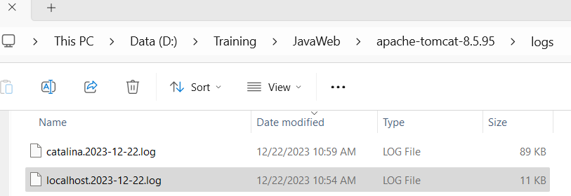
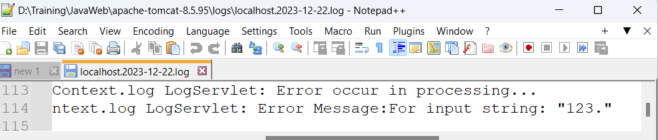
Error Handling in Servlet Logging Error

Slide 43
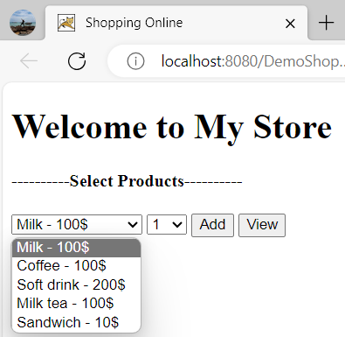
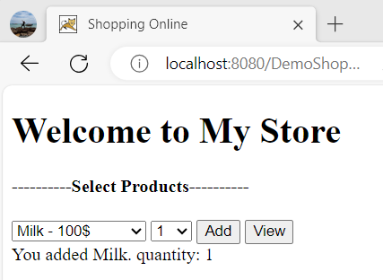
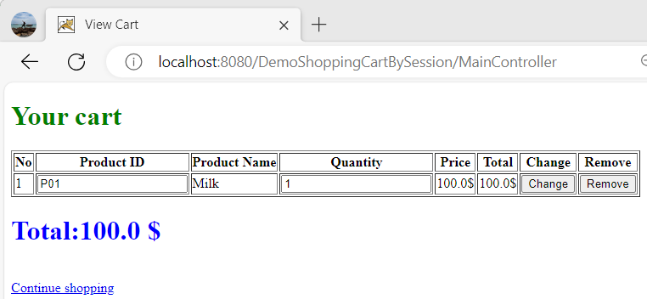
Build The Web App Shopping Cart

Slide 44
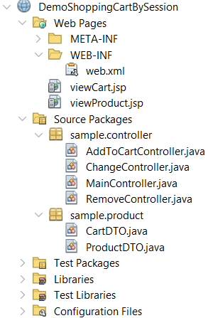
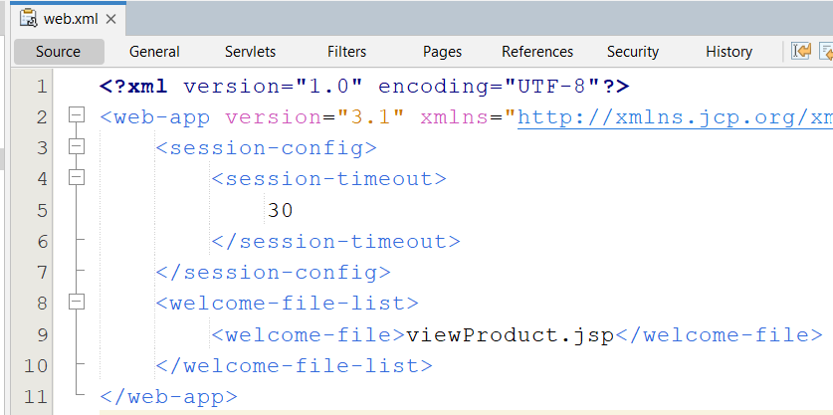
Build The Web App Shopping Cart
#1. Create web.xml

Slide 45
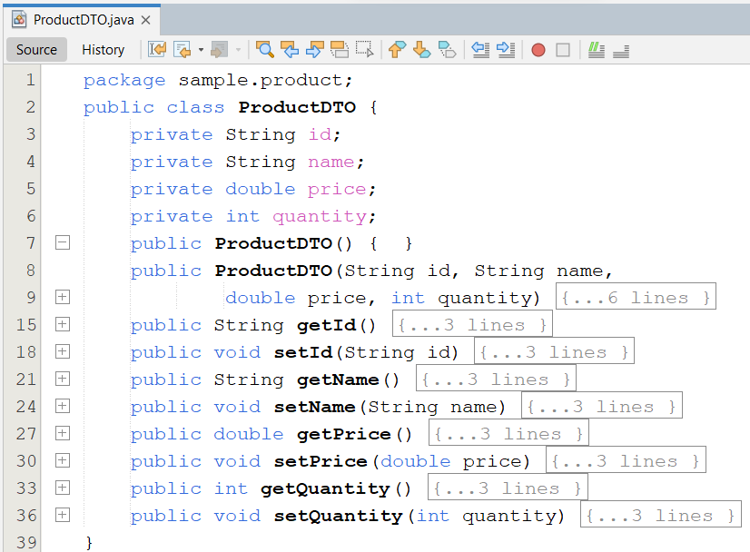
Build The Web App Shopping Cart
#2. Create ProductDTO.java

Slide 46
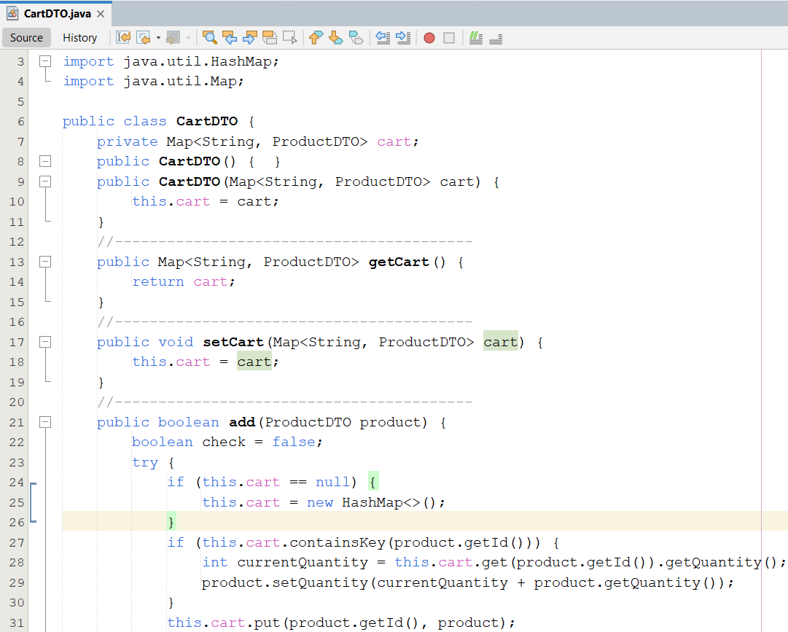
Build The Web App Shopping Cart
#3. Create CartDTO.java

Slide 47

Build The Web App Shopping Cart

Slide 48

Build The Web App Shopping Cart

Slide 49

Build The Web App Shopping Cart – View Product
#4. Create viewProduct.jsp

Slide 50

Build The Web App Shopping Cart
#5. Create MainController.java

Slide 51

Build The Web App Interactive Server Model – Add To Cart
2. Send request
1. Select Items
Web/App Server
Servlet
2. Add to Cart
6. Update Session & Response with shopping page
5. Check Cart Obj
3. Get Session
4.Get Cart Obj
Cart Obj
5.2. No → New
5.1. Yes → check existed item
5.1.2. No → New Item and Add To Cart
5.1.1. Yes → update existed item’s quantity
Client
Server

Slide 52

Build The Web App Shopping Cart – Add To Cart
#6 .Create AddToCartController.java

Slide 53
Build The Web App Interactive Server Model – View Cart
3. Get Session
2. Send request
Web/App Server
Servlet
1. Click View Carts
4.1. No → Error
4. Check Session
6. Response with display or error page
4.2. Yes → get Cart Obj
5.1. Yes → Traversal Obj to display
5.2. No → Error
Cart Obj
5. Check existed Object
Client
Server

Slide 54

Build The Web App Shopping Cart – View Cart
#7. Create viewCart.jsp

Slide 55

Build The Web App Shopping Cart – View Cart

Slide 56

Build The Web App Shopping Cart – Update Cart
#8. Create ChangeController.java

Slide 57
Build The Web App Interactive Server Model – Remove
7. Call View
again
3. Get Session
2. Send request
1. Select Items
Web/App Server
Servlet
2. Remove Cart
4.1. No → Error
4. Check Session
8. Response with display or error page
6.1. Yes → Remove
6.2. No → Error
4.2. Yes → get Cart Obj
5.2. No → Error
5. Check existed Object
Cart Obj
5.1. Yes → get selected items & 6. check
Client
Server

Slide 58

Build The Web App Shopping Cart – Remove Cart
#9. Create RemoveController.java

Slide 59
Summary
How to write CRUD Web Application
Session Tracking Techniques
Manipulate DB Techniques in Web Application
Break down structure component in building web application
Techniques: Error Handling in Servlets
Reporting Errors
Logging Errors
Users Errors vs. System Errors
Q&A

Slide 60
Next Lecture
JSP Standard Actions
JavaBeans
Standard Actions
Dispatcher Mechanism
Including, Forwarding, and Parameters
Vs. Dispatcher in Servlets
EL – Expression Languages
What is EL?
How to use EL in JSP?

Slide 61
Practice
Do Lab05_ShoppingCartMVC2.pdf

Slide 62



Appendix Shopping Cart using Cookies

Slide 63

Appendix Shopping Cart using Cookies

Slide 64
Appendix Interactive Server Model
2. Send request
1. Select Items
Web/App Server
Servlet
2. Add to Cart
5. Response with writing cookies and return page
4. Check cookies
3. Get Cookies
Get selected item
Cookie
4. No → New
4. Yes → check existed item
4. No → New
4. Yes → update existed item
Client
Server

Slide 65

Appendix Shopping Cart using Cookies

Slide 66

Appendix Shopping Cart using Cookies

Slide 67

Appendix Shopping Cart using Cookies

Slide 68
Appendix Interactive Server Model
3. Get Cookies
4. Check cookies
2. Send request
Web/App Server
Servlet
4’’. Yes → traversal cookies to display
1. Click View Carts
4’. No → Error
4. Check cookies
5. Response with display or error page
Client
Server

Slide 69

Appendix Shopping Cart using Cookies

Slide 70

Appendix Shopping Cart using Cookies

Slide 71

Appendix Shopping Cart using Cookies

Slide 72
Appendix Interactive Server Model
2. Send request
1. Select Items
Web/App Server
Servlet
2. Remove Cart
6. Response with reload page or show error msg
4. Check cookies
3. Get Cookies
Get selected items
4. No → create msg
4. Yes → update item value to 0
4’. Update Cookies object
Client
Server

Slide 73

Appendix Shopping Cart using Cookies

Slide 74

Appendix Shopping Cart using Cookies

Slide 75

Sessions & Listeners Shopping Cart using Cookies – Example

Slide 76

Appendix Request and Context Listeners
There are two things that need to do to set up a listener in a web application:
Write a class that implements the appropriate listener interface.
Register the class name in the web application deployment descriptor, web.xml.
<listener>
<listener-class>className</listener-class>
</listener>

Slide 77
Appendix Request Listeners
ServletRequestListener deals with the life cycle of each request object
A class implementing the ServletRequestListener interface has 2 methods
requestInitialized(): is called the moment that any request in the web container be comes newly available (or it is called at the beginning of any request’s scope)
This is at the beginning of a servlet’s service() method or earlier than that if filter chain is involved
requestDestroyed(): is called for each request that comes to an end – either at the end of the servlet’s service() method or at the end of the doFilter() method for the first filter in a chain
Each of these ServletRequestListener methods accept a ServletRequestEvent as a parameter. This event object has 2 methods
getServletContext()
getServletRequest()

Slide 78

Appendix Request Listeners

Slide 79
Appendix Request Attribute Listeners
ServletRequestAttributeListener deals with the life cycle of the attributes attached to request objects
A class implementing the ServletRequestAttributeListener interface has 3 methods
attributeAdded(): is called whenever a new attribute is added to any request
attributeRemoved(): is called whenever an attribute is removed from a request
attributeReplaced(): is called whenever an attribute is replaced
Each of these ServletRequestAttributeListener methods accept a ServletRequestAttributeEvent as a parameter. This event object has 2 methods
getName(): returns name of attribute
getValue(): returns old value of attribute
The ServletRequestAttributeEvent inherits from ServetRequestEvent
The “grandparent” of The ServletRequestEvent is java.util.EventObject
The getSource() method returns the object that is the source of the event

Slide 80

Appendix How to Add Listener to Web Project

Slide 81

Appendix How to Add Listener to Web Project

Slide 82


Appendix Example

Slide 83

Appendix Example

Slide 84

Appendix Example

Slide 85


Appendix Example

Slide 86




Appendix Practices – Example

Slide 87

Appendix Practices – Example

Slide 88

Appendix Practices – Example

Slide 89

Appendix Practices – Example

Slide 90
Appendix Context Listener
Contexts have 02 listeners:
ServletContextListener
Receive notifications about changes to the servlet context of the Web application
contextInitialized(): gets called before any servlet’s init() method or any filter’s doFilter() method
contextDestroyed(): gets called after the servlet’s or filter’s destroy() method
Both of methods get passed a ServletContextEvent object that provides the getServletContext() method
ServletContextAttributeListener
Recieves a notification about any modifications made to the attribute list on the servlet context of a web application
Has the same trio of methods as ServletRequestAttributeListener

Slide 91


Appendix Example

Slide 92

Appendix Example

Slide 93

Appendix Example

Slide 94


Appendix Example
Notes:
-To view Destroy context message : Must Undeploy Web App from Web Server Tomcat

Slide 95


Appendix Practices – Example

Slide 96

Appendix Practices – Example

Slide 97
Appendix Session Listeners Declared in DD
Sessions have 02 listeners:
HttpSessionListener
Implements the changes to the list of active sessions in Web application
sessionCreated() method: is called whenever a new session is provided (can say that after the getSession() method)
sessionDestroyed(): is called at the end of the sessions (within the call invalidate() or session time out but before the session become invalid)
Both of methods get passed a HttpSessionEvent object that provides the getSession() method
HttpSessionAttributeListener
Is called whenever some changes are made to the attribute list on the servlet session of a Web application
Is used to notify when an attribute has been added, removed or replaced by another attribute
Has the same trio of methods as ServletRequestAttributeListener that are passed the HttpSessionBindingEvent (is inherited from HttpSessionEvent)
Notes:
The configuration information can be specified using Java EE annotations or can be maintained in a text file in XML format called a web application Deployment Descriptor (DD). A web application DD must conform to the schema described in the Java Servlet specification.

Slide 98


Appendix Practices – Example

Slide 99

Appendix Practices – Example

Slide 100


Appendix Practices – Example

Slide 101


Appendix Practices – Example

Slide 102

Appendix Session Listeners Not Declared in DD
Have 02 listeners:
HttpSessionBindingListener
Notifies the object when it is being bound to or unbound from a session
This notification can be the result of a forced unbinding of an attribute from a session by the programmer, invalidation of the session or due to timing out of session
This implementation do not require any configuration within the deployment descriptor of the Web application
Notes: The object data types not implemented in BindingListener don’t fire any events!
Notes:
The configuration information can be specified using Java EE annotations or can be maintained in a text file in XML format called a web application Deployment Descriptor (DD). A web application DD must conform to the schema described in the Java Servlet specification.

Slide 103

Appendix Session Listeners Not Declared in DD - Example

Slide 104


Appendix Session Listeners Not Declared in DD - Example

Slide 105

Appendix Session Listeners Not Declared in DD
Have 02 listeners (cont)
HttpSesssionActivationListener (receives events when a value object is transported across JVMs).
Stateful session (activated and passivated)
Is implemented when a container migrates the session between VM or persists sessions and is not required any configuration within the deployment descriptor
Notes:
When the container decides to migrate the session to another VM, it must call the sessionWillPassivate() method. This indicates that the object will be serialized and transported to another JVM.
When the process of migration is complete, the sessionDidActivate() method is invoked. Telling the Object that it has migrated from one VM to another.

